Slide 1
Daniel 10: Spiritual Warfare – the heavenly realms
Prologue : Overview of the book of Daniel
Interlude – Spiritual Realm and Ships
Three Points
1. Know the King and the Kingdom
2. Know who you are
3. Understand the battle

Slide 2
Prologue : Overview of the book of Daniel

Slide 4
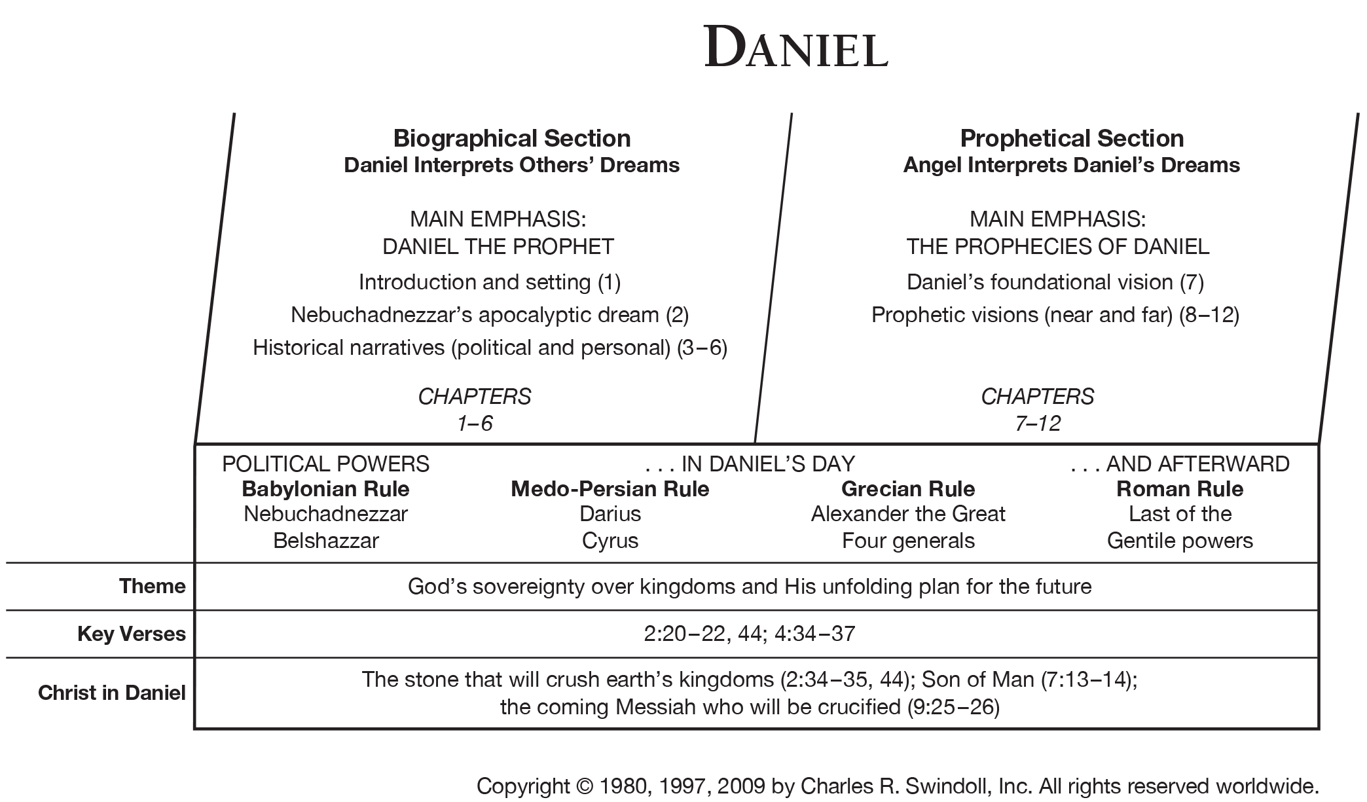

Slide 5
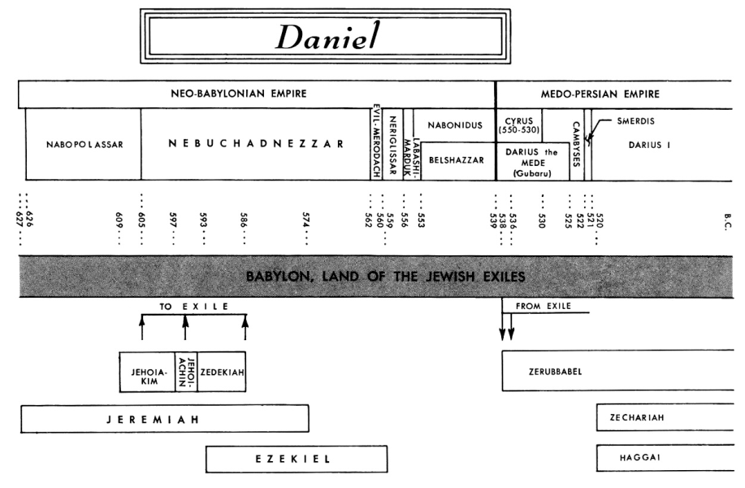

Slide 6
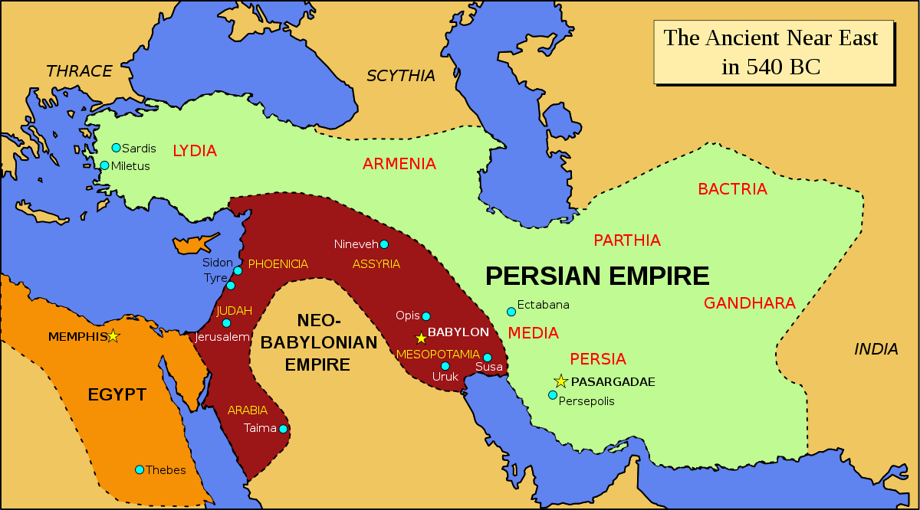

Slide 7
Prologue : Overview of the book of Daniel
Chapter 1 – How we got here
Nebuchadnezzar
Daniel, Shadrach, Meshach, Abednego – taken captive into Babylon
* Purity – Keeping holy

Slide 8
Prologue : Overview of the book of Daniel
Chapter 1 – How we got here
Nebuchadnezzar
Chapter 2 – Nebuchadnezzar’s Dream – The Statue
Nebuchadnezzar
2nd year

Slide 9
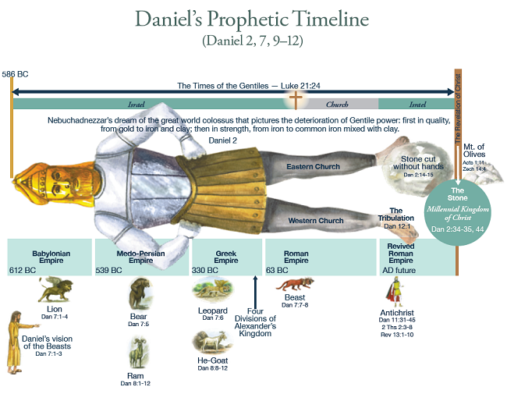
Prologue : Overview of the book of Daniel
Chapter 1 – How we got here
Nebuchadnezzar
Chapter 2 – Nebuchadnezzar’s Dream – The Statue
Nebuchadnezzar
2nd year
Statue – Head, chest and arms, belly and thighs, legs, feet
(gold) (silver) (bronze) (iron) (iron and clay)
Prophesy about coming kingdoms and the messiah

Slide 10
Prologue : Overview of the book of Daniel
Chapter 1 – How we got here
Nebuchadnezzar
Chapter 2 – Nebuchadnezzar’s Dream – The Statue
Nebuchadnezzar
2nd year
Statue – Head, chest and arms, belly and thighs, legs, feet
(gold) (silver) (bronze) (iron) (iron and clay)
Prophesy about coming kingdoms and the messiah
v14 “In the time of those kings, the God of heaven will set up a kingdom that will never be destroyed, nor will it be left to another people. It will crush all those kingdoms and bring them to an end, but it will itself endure for ever.”
* Timeline for the coming of the Messiah

Slide 11
Prologue : Overview of the book of Daniel
Chapter 1 – How we got here
Nebuchadnezzar
Chapter 2 – Nebuchadnezzar’s Dream – The Statue
Nebuchadnezzar
2nd Year
Chapter 3 – Fiery Furnace
Nebuchadnezzar
time unknown

Slide 12
Prologue : Overview of the book of Daniel
Chapter 1 – How we got here
Nebuchadnezzar
Chapter 2 – Nebuchadnezzar’s Dream – The Statue
Nebuchadnezzar
2nd Year
Chapter 3 – Fiery Furnace
Nebuchadnezzar
time unknown
Shadrach, Meshach, Abednego won’t worship other gods.
v17-18 “the God we serve is able to deliver us from it, and he will deliver us from Your Majesty’s hand. But even if he does not, we want you to know, Your Majesty, that we will not serve your gods or worship the image of gold you have set up.’”
Veggie tales Rack, Shack and Benny “Nobody bakes my buddies”
* Unconditional faithfulness to God
* Faith is NOT about results – it is about trust (what is my backup plan)
about who is in control
results – those are God’s responsibility.

Slide 13
Prologue : Overview of the book of Daniel
Chapter 1 – How we got here
Nebuchadnezzar
Chapter 2 – Nebuchadnezzar’s Dream – The Statue
Nebuchadnezzar
2nd Year
Chapter 3 – Fiery Furnace
Nebuchadnezzar
time unknown
Shadrach, Meshach, Abednego won’t worship other gods.
v17-18 “the God we serve is able to deliver us from it, and he will deliver us from Your Majesty’s hand. But even if he does not, we want you to know, Your Majesty, that we will not serve your gods or worship the image of gold you have set up.’”
Veggie tales Rack, Shack and Benny “Nobody bakes my buddies”
* Unconditional faithfulness to God
* Faith is NOT about results – it is about trust (what is my backup plan)
about who is in control
results – those are God’s responsibility.
* Obedience is NOT about results – but about doing what God asks

Slide 14
Prologue : Overview of the book of Daniel
Chapter 1 – How we got here
Nebuchadnezzar
Chapter 2 – Nebuchadnezzar’s Dream – The Statue
Nebuchadnezzar
2nd Year
Chapter 3 – Fiery Furnace
Nebuchadnezzar
time unknown
Chapter 4 – Nebuchadnezzar’s Dream – Tree
Nebuchadnezzar
time unknown

Slide 15
Prologue : Overview of the book of Daniel
Chapter 1 – How we got here
Nebuchadnezzar
Chapter 2 – Nebuchadnezzar’s Dream – The Statue
Nebuchadnezzar
2nd Year
Chapter 3 – Fiery Furnace
Nebuchadnezzar
time unknown
Chapter 4 – Nebuchadnezzar’s Dream – Tree
Nebuchadnezzar
time unknown
Pride and humility
Because of his pride he lost his sanity and lived as a wild animal until he raised his eyes towards heaven and his sanity was restored.
v37 “Now, I Nebuchadnezzar, praise and exalt and glorify the King of Heaven, because everything he does is right and all his ways are just. And those who walk in pride he is able to humble.”
* Humility before God

Slide 16
Prologue : Overview of the book of Daniel
Chapter 1 – How we got here
Nebuchadnezzar
Chapter 2 – Nebuchadnezzar’s Dream – The Statue
Nebuchadnezzar
2nd Year
Chapter 3 – Fiery Furnace
Nebuchadnezzar
time unknown
Chapter 4 – Nebuchadnezzar’s Dream – Tree
Nebuchadnezzar
time unknown
Chapter 5 – Handwriting on the Wall
Belshazzar
end of his reign

Slide 17
Prologue : Overview of the book of Daniel
Chapter 1 – How we got here
Nebuchadnezzar
Chapter 2 – Nebuchadnezzar’s Dream – The Statue
Nebuchadnezzar
2nd Year
Chapter 3 – Fiery Furnace
Nebuchadnezzar
time unknown
Chapter 4 – Nebuchadnezzar’s Dream – Tree
Nebuchadnezzar
time unknown
Chapter 5 – Handwriting on the Wall
Belshazzar
end of his reign
Take goblets that were from the temple in Jerusalem
and used them at a party – not respecting God.
v26 “Mene, Mene, Tekel, Parsin”
* Humility before God – not treated what is God’s as sacred.

Slide 18
Prologue : Overview of the book of Daniel
Chapter 1 – How we got here
Nebuchadnezzar
Chapter 2 – Nebuchadnezzar’s Dream – The Statue
Nebuchadnezzar
2nd Year
Chapter 3 – Fiery Furnace
Nebuchadnezzar
time unknown
Chapter 4 – Nebuchadnezzar’s Dream – Tree
Nebuchadnezzar
time unknown
Chapter 5 – Handwriting on the Wall
Belshazzar
end of his reign
Chapter 6 – Daniel in the Lions’ Den
Darius (Mede)
time unknown

Slide 19
Prologue : Overview of the book of Daniel
Chapter 1 – How we got here
Nebuchadnezzar
Chapter 2 – Nebuchadnezzar’s Dream – The Statue
Nebuchadnezzar
2nd Year
Chapter 3 – Fiery Furnace
Nebuchadnezzar
time unknown
Chapter 4 – Nebuchadnezzar’s Dream – Tree
Nebuchadnezzar
time unknown
Chapter 5 – Handwriting on the Wall
Belshazzar
end of his reign
Chapter 6 – Daniel in the Lions’ Den
Darius (Mede)
time unknown
Daniel told to pray to the king and he won’t.
Daniel thrown to the lions but God protects him.
v26 Darius “I issues a decree that in every part of my kingdom people must fear and reverence the God of Daniel.”
* Unconditional faithfulness to God

Slide 20
Prologue : Overview of the book of Daniel
Chapter 1 – How we got here
Nebuchadnezzar
Chapter 2 – Nebuchadnezzar’s Dream – The Statue
Nebuchadnezzar
2nd Year
Chapter 3 – Fiery Furnace
Nebuchadnezzar
time unknown
Chapter 4 – Nebuchadnezzar’s Dream – Tree
Nebuchadnezzar
time unknown
Chapter 5 – Handwriting on the Wall
Belshazzar
end of his reign
Chapter 6 – Daniel in the Lions’ Den
Darius (Mede)
time unknown
Chapter 7 – Daniel’s Dream – Four Great Beasts
Belshazzar
1st year

Slide 21
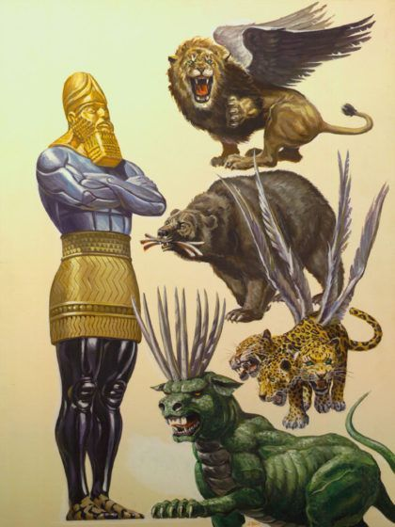
Prologue : Overview of the book of Daniel
Chapter 1 – How we got here
Nebuchadnezzar
Chapter 2 – Nebuchadnezzar’s Dream – The Statue
Nebuchadnezzar
2nd Year
Chapter 3 – Fiery Furnace
Nebuchadnezzar
time unknown
Chapter 4 – Nebuchadnezzar’s Dream – Tree
Nebuchadnezzar
time unknown
Chapter 5 – Handwriting on the Wall
Belshazzar
end of his reign
Chapter 6 – Daniel in the Lions’ Den
Darius (Mede)
time unknown
Chapter 7 – Daniel’s Dream – Four Great Beasts
Belshazzar
1st year
The dream is pretty weird.

Slide 22
Prologue : Overview of the book of Daniel
Chapter 1 – How we got here
Nebuchadnezzar
Chapter 2 – Nebuchadnezzar’s Dream – The Statue
Nebuchadnezzar
2nd Year
Chapter 3 – Fiery Furnace
Nebuchadnezzar
time unknown
Chapter 4 – Nebuchadnezzar’s Dream – Tree
Nebuchadnezzar
time unknown
Chapter 5 – Handwriting on the Wall
Belshazzar
end of his reign
Chapter 6 – Daniel in the Lions’ Den
Darius (Mede)
time unknown
Chapter 7 – Daniel’s Dream – Four Great Beasts
Belshazzar
1st year
The dream is pretty weird.
v15 “I Daniel, was troubled in spirit and the visions
that passed through my mind disturbed me.”
v16 “asked the true meaning”
v27 “the kingdoms under the whole heaven will be
handed over to the saints, the people of the
Most High. His kingdom will be an everlasting
kingdom and all rulers will worship and obey him.”
* Another promise of the Messiah

Slide 23
Prologue : Overview of the book of Daniel
Chapter 1 – How we got here
Nebuchadnezzar
Chapter 2 – Nebuchadnezzar’s Dream – The Statue
Nebuchadnezzar
2nd Year
Chapter 3 – Fiery Furnace
Nebuchadnezzar
time unknown
Chapter 4 – Nebuchadnezzar’s Dream – Tree
Nebuchadnezzar
time unknown
Chapter 5 – Handwriting on the Wall
Belshazzar
end of his reign
Chapter 6 – Daniel in the Lions’ Den
Darius (Mede)
time unknown
Chapter 7 – Daniel’s Dream – Four Great Beasts
Belshazzar
1st year
Chapter 8 – Daniel’s Dream – Ram and Goat
Belshazzar
3rd year

Slide 24
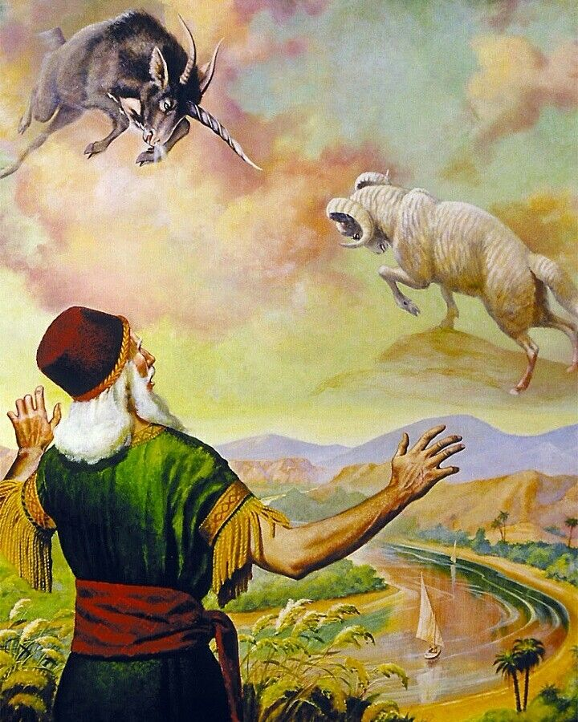
Prologue : Overview of the book of Daniel
Chapter 1 – How we got here
Nebuchadnezzar
Chapter 2 – Nebuchadnezzar’s Dream – The Statue
Nebuchadnezzar
2nd Year
Chapter 3 – Fiery Furnace
Nebuchadnezzar
time unknown
Chapter 4 – Nebuchadnezzar’s Dream – Tree
Nebuchadnezzar
time unknown
Chapter 5 – Handwriting on the Wall
Belshazzar
end of his reign
Chapter 6 – Daniel in the Lions’ Den
Darius (Mede)
time unknown
Chapter 7 – Daniel’s Dream – Four Great Beasts
Belshazzar
1st year
Chapter 8 – Daniel’s Dream – Ram and Goat
Belshazzar
3rd year
Even more weird.

Slide 25
Prologue : Overview of the book of Daniel
Chapter 1 – How we got here
Nebuchadnezzar
Chapter 2 – Nebuchadnezzar’s Dream – The Statue
Nebuchadnezzar
2nd Year
Chapter 3 – Fiery Furnace
Nebuchadnezzar
time unknown
Chapter 4 – Nebuchadnezzar’s Dream – Tree
Nebuchadnezzar
time unknown
Chapter 5 – Handwriting on the Wall
Belshazzar
end of his reign
Chapter 6 – Daniel in the Lions’ Den
Darius (Mede)
time unknown
Chapter 7 – Daniel’s Dream – Four Great Beasts
Belshazzar
1st year
Chapter 8 – Daniel’s Dream – Ram and Goat
Belshazzar
3rd year
Even more weird.
Kingdoms divided – restoration of Temple and worship.
Daniel knows he needs to understand this.
v16 Angel comes “Gabriel, tell this man the meaning of the vision.”
v27 “I, Daniel, was exhausted and lay ill for several days. Then
I got up and went about the king’s business.”
* Gabriel shows up to explain the coming of the Messiah

Slide 26
Prologue : Overview of the book of Daniel
Chapter 1 – How we got here
Nebuchadnezzar
Chapter 2 – Nebuchadnezzar’s Dream – The Statue
Nebuchadnezzar
2nd Year
Chapter 3 – Fiery Furnace
Nebuchadnezzar
time unknown
Chapter 4 – Nebuchadnezzar’s Dream – Tree
Nebuchadnezzar
time unknown
Chapter 5 – Handwriting on the Wall
Belshazzar
end of his reign
Chapter 6 – Daniel in the Lions’ Den
Darius (Mede)
time unknown
Chapter 7 – Daniel’s Dream – Four Great Beasts
Belshazzar
1st year
Chapter 8 – Daniel’s Dream – Ram and Goat
Belshazzar
3rd year
Chapter 9 – Daniel’s Prayer – Confession and Repentance
Darius (Mede)
1st year

Slide 27
Prologue : Overview of the book of Daniel
Chapter 1 – How we got here
Nebuchadnezzar
Chapter 2 – Nebuchadnezzar’s Dream – The Statue
Nebuchadnezzar
2nd Year
Chapter 3 – Fiery Furnace
Nebuchadnezzar
time unknown
Chapter 4 – Nebuchadnezzar’s Dream – Tree
Nebuchadnezzar
time unknown
Chapter 5 – Handwriting on the Wall
Belshazzar
end of his reign
Chapter 6 – Daniel in the Lions’ Den
Darius (Mede)
time unknown
Chapter 7 – Daniel’s Dream – Four Great Beasts
Belshazzar
1st year
Chapter 8 – Daniel’s Dream – Ram and Goat
Belshazzar
3rd year
Chapter 9 – Daniel’s Prayer – Confession and Repentance
Darius (Mede)
1st year
Confession and repentance on behalf of God’s people.
v21 Gabriel comes again (pretty much straight away)
The Seventy “Sevens”
v25 “until the Anointed One comes”
foretells that the Messiah will be killed and Jerusalem destroyed.
Personally – don’t know why God didn’t have Gabriel add about the resurrection
– to add to my list of questions.
* Again Gabriel is announcing the Messiah

Slide 28
Prologue : Overview of the book of Daniel
Chapter 1 – How we got here
Nebuchadnezzar
Chapter 2 – Nebuchadnezzar’s Dream – The Statue
Nebuchadnezzar
2nd Year
Chapter 3 – Fiery Furnace
Nebuchadnezzar
time unknown
Chapter 4 – Nebuchadnezzar’s Dream – Tree
Nebuchadnezzar
time unknown
Chapter 5 – Handwriting on the Wall
Belshazzar
end of his reign
Chapter 6 – Daniel in the Lions’ Den
Darius (Mede)
time unknown
Chapter 7 – Daniel’s Dream – Four Great Beasts
Belshazzar
1st year
Chapter 8 – Daniel’s Dream – Ram and Goat
Belshazzar
3rd year
Chapter 9 – Daniel’s Prayer – Confession and Repentance
Darius (Mede)
1st year
Chapter 10 – Daniel’s Vision of a Man
Cyrus (Persian)
3rd year

Slide 29
Prologue : Overview of the book of Daniel
Chapter 10 – Daniel’s Vision of a Man
Cyrus (Persian)
3rd year

Slide 30
Prologue : Overview of the book of Daniel
Chapter 10 – Daniel’s Vision of a Man
Cyrus (Persian)
3rd year
Has a vision – knows its important – doesn’t know why.
Knows he needs to pray
Begins to fast and pray for 3 weeks
An Angel comes (this time doesn’t tell us who – but very possibly Gabriel)
v11 “Daniel, you who are highly esteemed (by God), . . . I have been sent to you.”
v12 “Since the first day that you set your mind to gain understanding and to humble yourself before your God, your words were heard, and I have come in response…”
v13 “But the prince of the Persian kingdom resisted me twenty-one days. Then Michael, one of the chief princes, came to help”
v14 “Now I have come to explain … a time yet to come.”
v21 “But first I will tell you what is written in the Book of Truth.”
* There is some really significant battle going on here that takes three weeks.

Slide 31
Prologue : Overview of the book of Daniel
Chapter 1 – How we got here
Nebuchadnezzar
Chapter 2 – Nebuchadnezzar’s Dream – The Statue
Nebuchadnezzar
2nd Year
Chapter 3 – Fiery Furnace
Nebuchadnezzar
time unknown
Chapter 4 – Nebuchadnezzar’s Dream – Tree
Nebuchadnezzar
time unknown
Chapter 5 – Handwriting on the Wall
Belshazzar
end of his reign
Chapter 6 – Daniel in the Lions’ Den
Darius (Mede)
time unknown
Chapter 7 – Daniel’s Dream – Four Great Beasts
Belshazzar
1st year
Chapter 8 – Daniel’s Dream – Ram and Goat
Belshazzar
3rd year
Chapter 9 – Daniel’s Prayer – Confession and Repentance
Darius (Mede)
1st year
Chapter 10 – Daniel’s Vision of a Man
Cyrus (Persian)
3rd year

Slide 32
Prologue : Overview of the book of Daniel
Chapter 1 – How we got here
Nebuchadnezzar
Chapter 2 – Nebuchadnezzar’s Dream – The Statue
Nebuchadnezzar
2nd Year
Chapter 3 – Fiery Furnace
Nebuchadnezzar
time unknown
Chapter 4 – Nebuchadnezzar’s Dream – Tree
Nebuchadnezzar
time unknown
Chapter 5 – Handwriting on the Wall
Belshazzar
end of his reign
Chapter 6 – Daniel in the Lions’ Den
Darius (Mede)
time unknown
Chapter 7 – Daniel’s Dream – Four Great Beasts
Belshazzar
1st year
Chapter 8 – Daniel’s Dream – Ram and Goat
Belshazzar
3rd year
Chapter 9 – Daniel’s Prayer – Confession and Repentance
Darius (Mede)
1st year
Chapter 10 – Daniel’s Vision of a Man
Cyrus (Persian)
3rd year
Chapter 11 – The Angel’s Message – Kings of the North and South
Not specified
time unknown

Slide 33
Prologue : Overview of the book of Daniel
Chapter 1 – How we got here
Nebuchadnezzar
Chapter 2 – Nebuchadnezzar’s Dream – The Statue
Nebuchadnezzar
2nd Year
Chapter 3 – Fiery Furnace
Nebuchadnezzar
time unknown
Chapter 4 – Nebuchadnezzar’s Dream – Tree
Nebuchadnezzar
time unknown
Chapter 5 – Handwriting on the Wall
Belshazzar
end of his reign
Chapter 6 – Daniel in the Lions’ Den
Darius (Mede)
time unknown
Chapter 7 – Daniel’s Dream – Four Great Beasts
Belshazzar
1st year
Chapter 8 – Daniel’s Dream – Ram and Goat
Belshazzar
3rd year
Chapter 9 – Daniel’s Prayer – Confession and Repentance
Darius (Mede)
1st year
Chapter 10 – Daniel’s Vision of a Man
Cyrus (Persian)
3rd year
Chapter 11 – The Angel’s Message – Kings of the North and South
Not specified
time unknown
Chapter 12 – The Angel’s Message – The End Times
Not specified
time unknown

Slide 34
Prologue : Overview of the book of Daniel
So what have we learned from Daniel:
God’s people are called to be obedient and faithful to what God has called.
Some weird things going on and they need to understand them.
At the heart is coming of the Messiah.
Promise of the Messiah isn’t new – but any kind of timeline is new. Significant.
It might take time. God doesn’t always work in instant fix.

Slide 35
Daniel: a New Testament Perspective – coming Messiah

Slide 36
Daniel: a New Testament Perspective – coming Messiah
Simeon: Luke 2 : 25-35
v26 “it had been revealed to him by the Holy Spirit that he would not die before he had seen the Lord’s Messiah.”
Don’t know how the Holy Spirit revealed – but probably through Daniels writings.
In faith Simeon goes to the temple – to be there prophetically welcome the Messiah and to bless Jesus and his family.

Slide 37
Daniel: a New Testament Perspective – coming Messiah
Simeon: Luke 2 : 25-35
v26 “it had been revealed to him by the Holy Spirit that he would not die before he had seen the Lord’s Messiah.”
Don’t know how the Holy Spirit revealed – but probably through Daniels writings.
In faith Simeon goes to the temple – to be there prophetically welcome the Messiah and to bless Jesus and his family.
Anna: Luke 2 : 36-38
Prophetess.
She lived at the temple – something between 60 years and 84 years – waiting
v26 “looking forward to the redemption of Jerusalem.”

Slide 38
Daniel: a New Testament Perspective – coming Messiah
Simeon: Luke 2 : 25-35
Anna: Luke 2 : 36-38
Mary: Luke 1 : 26-38
Angel tells Mary, even though a virgin, she is to be the mother of the Messiah.
In ANY book that is weird – and wild – and unbelievable.
Marry is going to need confirmation.
v26 “God sent the angel Gabriel to Nazareth, a town in Galilee, to a virgin pledged to be married to a man named Joseph, a descendant of David. The virgin’s name was Mary.”
Mary must have know her scripture and history. She had read Daniel.
She knew the only time Gabriel had come was to announce the Messiah.
God’s confirmation

Slide 39
Daniel: a New Testament Perspective – coming Messiah
Simeon: Luke 2 : 25-35
Anna: Luke 2 : 36-38
Mary: Luke 1 : 26-38
Joseph: Matthew 1 : 18-25
Angel goes to Joseph
v21 “you are to give him the name Jesus, because he will save his people from their sins.”
v26 “you will call Him Immanuel, which means ‘God with us’.”

Slide 40
Daniel: a New Testament Perspective – coming Messiah
Simeon: Luke 2 : 25-35
Anna: Luke 2 : 36-38
Mary: Luke 1 : 26-38
Joseph: Matthew 1 : 18-25
Zechariah: Luke 1 : 5-25
Was a priest – serving, burning incense in the Holy of Holies in the Temple – should have known scripture.
Zechariah doubt – how can this be?
v19 “The Angel answered ‘I am Gabriel, I stand in the presence of God’.”
(remember Daniel)

Slide 41
Daniel: a New Testament Perspective – coming Messiah
Simeon: Luke 2 : 25-35
Anna: Luke 2 : 36-38
Mary: Luke 1 : 26-38
Joseph: Matthew 1 : 18-25
Zechariah: Luke 1 : 5-25
Was a priest – serving, burning incense in the Holy of Holies in the Temple – should have known scripture.
Zechariah doubt – how can this be?
v19 “The Angel answered ‘I am Gabriel, I stand in the presence of God’.”
(remember Daniel)
Daniel was God’s way of lining all this up. It was about the coming of the Messiah.
That is why it was was a big battle – a HUGE battle.

Slide 42
Interlude – Spiritual Realm and Ships

Slide 43
Interlude – Spiritual Realm and Ships
Ephesians 6:12-13
“For our struggle is not against flesh and blood, but against the rulers, against the authorities, against the powers of this dark world and against the spiritual forces of evil in the heavenly realms. Therefore put on the full armour of God”

Slide 44
Interlude – Spiritual Realm and Ships
Ephesians 6:12-13
“For our struggle is not against flesh and blood, but against the rulers, against the authorities, against the powers of this dark world and against the spiritual forces of evil in the heavenly realms. Therefore put on the full armour of God”
Spiritual Realm?
Science: its about what I can see, and touch and measure – things that aren’t physical aren’t real.

Slide 45
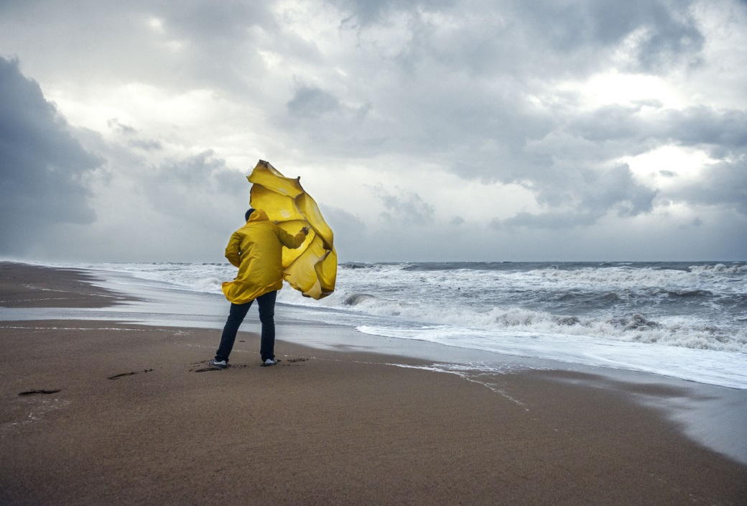
Interlude – Spiritual Realm and Ships
Ephesians 6:12-13
“For our struggle is not against flesh and blood, but against the rulers, against the authorities, against the powers of this dark world and against the spiritual forces of evil in the heavenly realms. Therefore put on the full armour of God”
Spiritual Realm?
Science: its about what I can see, and touch and measure – things that aren’t physical aren’t real.
Wind?
I can’t see it
I can see what it does but not wind itself
But it is still very real

Slide 46
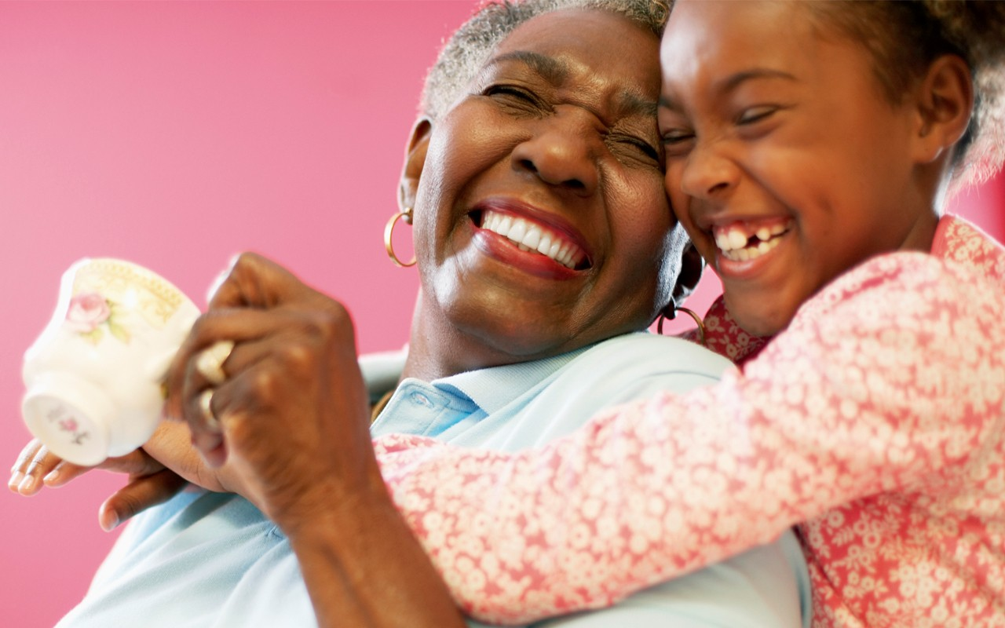
Interlude – Spiritual Realm and Ships
Ephesians 6:12-13
“For our struggle is not against flesh and blood, but against the rulers, against the authorities, against the powers of this dark world and against the spiritual forces of evil in the heavenly realms. Therefore put on the full armour of God”
Spiritual Realm?
Science: its about what I can see, and touch and measure – things that aren’t physical aren’t real.
Love?
Can I measure it?
Can I bottle it?
Can I control it? But it is very real!

Slide 47
Interlude – Spiritual Realm and Ships
Ephesians 6:12-13
“For our struggle is not against flesh and blood, but against the rulers, against the authorities, against the powers of this dark world and against the spiritual forces of evil in the heavenly realms. Therefore put on the full armour of God”
Spiritual Realm
An African perspective

Slide 48
Interlude – Spiritual Realm and Ships
Ephesians 6:12-13
“For our struggle is not against flesh and blood, but against the rulers, against the authorities, against the powers of this dark world and against the spiritual forces of evil in the heavenly realms. Therefore put on the full armour of God”
Spiritual Realm
Narnia

Slide 49
Interlude – Spiritual Realm and Ships
When they turned around, they saw that the Stone Table had been broken in half, and Aslan had disappeared.
Lucy asked if this was more magic, and a voice behind her answered her, telling her that it was, indeed, more magic.
When they turned around again, they saw Aslan, alive and well. They rushed to him, with Susan asking him if he was a ghost. He alleviated their fears, though, with his warm breath. To answer their question, he explained that the Witch was right, that The Deep Magic had decreed that all traitors' lives are forfeited to her, but if she had looked back before the dawn of time, she would have read a different incantation: -
"It means that though the Witch knew the Deep Magic, there is a magic deeper still which she did not know. Her knowledge goes back only to the dawn of time. But if she could have looked a little further back, into the stillness and the darkness before Time dawned, she would have read there a different incantation. She would have known that when a willing victim who had committed no treachery was killed in a traitor's stead, the Table would crack and Death itself would start working backwards."

Slide 50
Interlude – Spiritual Realm and Ships
Ephesians 6:12-13
“For our struggle is not against flesh and blood, but against the rulers, against the authorities, against the powers of this dark world and against the spiritual forces of evil in the heavenly realms. Therefore put on the full armour of God”
Yes there is a Spiritual Realm
But it’s not just about us – it is about God

Slide 51
Interlude – Spiritual Realm and Ships
Ephesians 6:12-13
“For our struggle is not against flesh and blood, but against the rulers, against the authorities, against the powers of this dark world and against the spiritual forces of evil in the heavenly realms. Therefore put on the full armour of God”
Yes there is a Spiritual Realm
But it’s not just about us – it is about God
Exodus 14 : 13-14
“Moses answered the people, ‘Do not be afraid. Stand firm and you will see the deliverance the Lord will bring you today. The Egyptians you see today you will never see again. The Lord will fight for you; you need only to be still.’”

Slide 52
Interlude – Spiritual Realm and Ships
Ephesians 6:12-13
“For our struggle is not against flesh and blood, but against the rulers, against the authorities, against the powers of this dark world and against the spiritual forces of evil in the heavenly realms. Therefore put on the full armour of God”
Yes there is a Spiritual Realm
But it’s not just about us – it is about God
Exodus 14 : 13-14
“Moses answered the people, ‘Do not be afraid. Stand firm and you will see the deliverance the Lord will bring you today. The Egyptians you see today you will never see again. The Lord will fight for you; you need only to be still.’”
2 Chronicles 20 - Jehoshaphat
v15 “Don’t be afraid … the battle is not yours, but God’s”
v16 “Take up your position, stand firm, and see the deliverance”
v22 “As they began to sing and praise …”

Slide 53
Cruise Ship
Battle Ship
Interlude – Spiritual Realm and Ships
So I can relax and rest and enjoy the world. It’s about me and what I receive.
To win the battle. Serving and giving. To complete the mission of the Kingdom.
The Captain and the crew are there to serve me – so that I am happy.
I am there to serve the Kingdom. Together our objectives is to win the battle.
The food, the entertainment...
The mission – the Kingdom’s purpose.
I play by my rules.
I serve according to the laws of the Kingdom.
I pay the cost. I have to come up with the resources. Its my entertainment.
The Kingdom supplies the weapons and ammunition, the resources, the funding. The battle belongs to the Kingdom.

Slide 54
Three Points
1. Know the King and the Kingdom
2. Know who you are
3. Understand the battle

Slide 55
Three Points
1. Know the King and the Kingdom
Get to know the King – know Him well – spend time just hanging out
Know His character
Know what His heart beat is

Slide 56
Three Points
1. Know the King and the Kingdom
Get to know the King – know Him well – spend time just hanging out
Know His character
Know what His heart beat is
Get to know the Kingdom
Know the values
Know what is important

Slide 57
Three Points
1. Know the King and the Kingdom
Get to know the King – know Him well – spend time just hanging out
Know His character
Know what His heart beat is
Get to know the Kingdom
Know the values
Know what is important
Luke 7 : 18-23
“At that very time Jesus cured many who had diseases, illnesses and evil spirits, and gave sight to many who were blind. So he replied to the messengers, ‘Go back and report to John what you have seen and heard: the blind receive sight, the lame walk, those who have leprosy are cleansed, the deaf hear, the dead are raised, and the good news is proclaimed to the poor.”

Slide 58
Three Points
1. Know the King and the Kingdom
2. Know who you are

Slide 59
Three Points
1. Know the King and the Kingdom
2. Know who you are
God has two purposes for each of us:
1. God love me passionately and wants me to become more like Jesus
resonate Jesus
2. God loves everyone passionate and Through us God wants reach out to the world

Slide 60
Three Points
1. Know the King and the Kingdom
2. Know who you are
God has two purposes for each of us:
1. God love me passionately and wants me to become more like Jesus
resonate Jesus
2. God loves everyone passionate and Through us God wants reach out to the world
Romans 8 : 38-39
“For I am convinced that neither death nor life, neither angels nor demons,
neither the present nor the future, nor any powers, neither height nor depth,
nor anything else in all creation, will be able to separate us from the love of God that is in Christ Jesus our Lord.’”

Slide 61
Three Points
1. Know the King and the Kingdom
2. Know who you are
God has two purposes for each of us:
1. God love me passionately and wants me to become more like Jesus
resonate Jesus
2. God loves everyone passionate and Through us God wants reach out to the world
Matthew 22 : 18-23
“‘Teacher, which is the greatest commandment in the Law?’
Jesus replied: ‘“Love the Lord your God with all your heart and with all your soul and with all your mind.” This is the first and greatest commandment.
And the second is like it: “Love your neighbour as yourself.”
All the Law and the Prophets hang on these two commandments.’”

Slide 62
Three Points
1. Know the King and the Kingdom
2. Know who you are
3. Understand the battle

Slide 63
Three Points
1. Know the King and the Kingdom
2. Know who you are
3. Understand the battle
How does God see things
What is God’s vision
What is God’s purpose
What is God doing

Slide 64
Three Points
1. Know the King and the Kingdom
2. Know who you are
3. Understand the battle
How does God see things
What is God’s vision
What is God’s purpose
What is God doing
Acts 3 – The Holy Spirit
heals the Crippled Beggar
at the Gate Beautiful
through Peter and John

Slide 65
Three Points
1. Know the King and the Kingdom
2. Know who you are
3. Understand the battle
“Now a man who was lame from birth was being carried to the temple gate called Beautiful, where he was put every day to beg from those going into the temple courts.”
How does God see things
What is God’s vision
What is God’s purpose
What is God doing
Acts 3 – The Holy Spirit
heals the Crippled Beggar
at the Gate Beautiful
through Peter and John

Slide 66
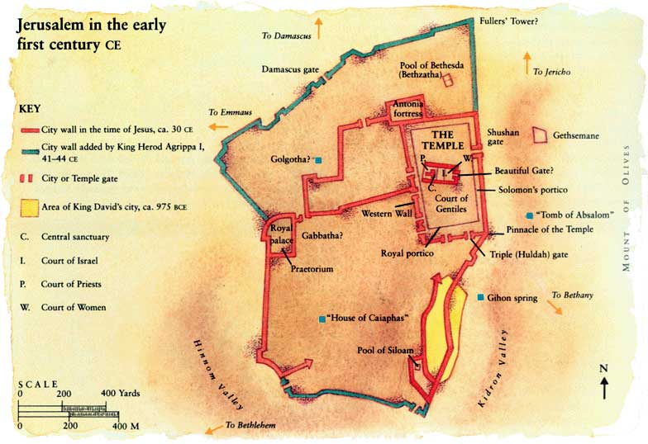
Three Points
1. Know the King and the Kingdom
2. Know who you are
3. Understand the battle
“Now a man who was lame from birth was being carried to the temple gate called Beautiful, where he was put every day to beg from those going into the temple courts.”
How does God see things
What is God’s vision
What is God’s purpose
What is God doing
Acts 3 – The Holy Spirit
heals the Crippled Beggar
at the Gate Beautiful
through Peter and John

Slide 67
Three Points
1. Know the King and the Kingdom
2. Know who you are
3. Understand the battle
“Now a man who was lame from birth was being carried to the temple gate called Beautiful, where he was put every day to beg from those going into the temple courts.”
How does God see things
What is God’s vision
What is God’s purpose
What is God doing
John 5 : 19
“Jesus gave them this answer: ‘Very truly I tell you, the Son can do nothing by himself;
he can do only what he sees his Father doing, because whatever the Father does the Son also does.”

Slide 68
Three Points
1. Know the King and the Kingdom
2. Know who you are
3. Understand the battle

Slide 69
Three Points
1. Know the King and the Kingdom
2. Know who you are
3. Understand the battle
What is happening in the battle? – where is the attack coming from? Re-align accordingly

Slide 70
Three Points
1. Know the King and the Kingdom
2. Know who you are
3. Understand the battle
What is happening in the battle? – where is the attack coming from? Re-align accordingly
Communication

Slide 71
Three Points
1. Know the King and the Kingdom
2. Know who you are
3. Understand the battle
What is happening in the battle? – where is the attack coming from? Re-align accordingly
Communication
Unity within the family

Slide 72
Three Points
1. Know the King and the Kingdom
2. Know who you are
3. Understand the battle
What is happening in the battle? – where is the attack coming from? Re-align accordingly
Communication
Unity within the family
People knowing God’s value

Slide 73
Three Points
1. Know the King and the Kingdom
2. Know who you are
3. Understand the battle
How does God see things

Slide 74
Three Points
1. Know the King and the Kingdom
2. Know who you are
3. Understand the battle
How does God see things
What is happening in the battle – re-align accordingly

Slide 75
Three Points
1. Know the King and the Kingdom
2. Know who you are
3. Understand the battle
How does God see things
What is happening in the battle – re-align accordingly
Ask God for His perspective

Slide 76
Three Points
1. Know the King and the Kingdom
2. Know who you are
3. Understand the battle
How does God see things
What is happening in the battle – re-align accordingly
Ask God for His perspective
2 Kings 6 : 15-17
“When the servant of the man of God got up and went out early the next morning, an army with horses and chariots had surrounded the city. ‘Oh no, my lord! What shall we do?’ the servant asked.
‘Don’t be afraid,’ the prophet answered. ‘Those who are with us are more than those who are with them.’
And Elisha prayed, ‘Open his eyes, Lord, so that he may see.’ Then the Lord opened the servant’s eyes, and he looked and saw the hills full of horses and chariots of fire all round Elisha.”

Slide 77
Three Points
1. Know the King and the Kingdom
2. Know who you are
3. Understand the battle
How does God see things
What is happening in the battle – re-align accordingly
Ask God for His perspective
2 Kings 6 : 15-17
“When the servant of the man of God got up and went out early the next morning, an army with horses and chariots had surrounded the city. ‘Oh no, my lord! What shall we do?’ the servant asked.
‘Don’t be afraid,’ the prophet answered. ‘Those who are with us are more than those who are with them.’
And Elisha prayed, ‘Open his eyes, Lord, so that he may see.’ Then the Lord opened the servant’s eyes, and he looked and saw the hills full of horses and chariots of fire all round Elisha.”

